Slide 1
Hydroponic Chamber
Yu-Hsuan (Teddy) Chao
Lauren Grice
Jordan Weaver

Slide 2
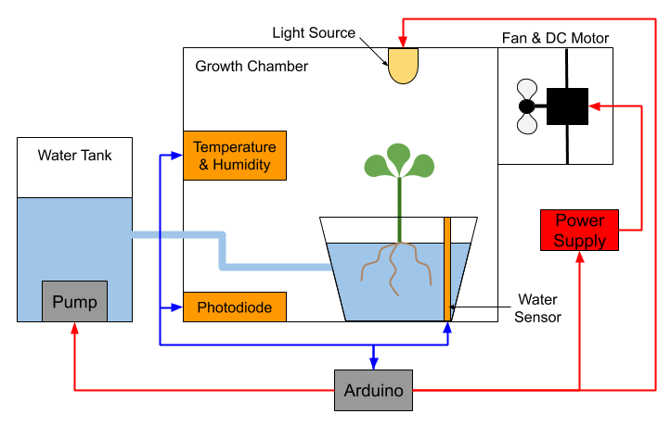
Background
Project: One Plant Hydroponic Chamber
Maintain control of:
Water level
Light exposure
Temperature
Relative humidity
Seeks to address problems with current hydroponics
Notes:
Our project idea was to create a 1 plant hydroponic chamber. A diagram of the proposed chamber is seen on the left.
The goal was to implement communication between an Arduino microcontroller and LabView program to control the water level, light exposure, temperature, and relative humidity within the chamber. We proposed the use a water pump, light source, and fan to control these conditions.
Using this prototype system, we sought to address a major drawback of real life hydroponic systems: the constant monitoring and adjusting of the system to maintain optimal growing conditions. Ideally the proposed system sought to control chamber conditions by periodically sampling sensor data instead of doing so continuously to conserve power.

Slide 3
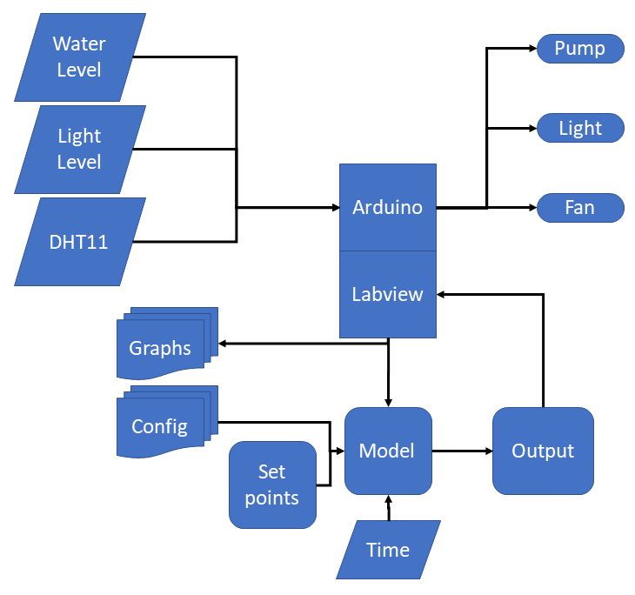
Flow Chart
Notes:
This flow chart details the pathways of communication between subsystems in the chamber.
The project utilized the water level and temperature and humidity sensors provided in the kit as well as a photodiode for light level sensing. We input the Arduino sensor data (which I mentioned on the previous slide), user set points, and current time into the Labview code, which uses internal models of the system to return control outputs to the Arduino.
For example, the system only adds supplemental light during a predefined schedule and not just when the photodiode registers dark.

Slide 4
Goals
Initial Goal | Achievement Status
Maintain Water Level | 50% - Needs relay, pump, reservoir, & piping
Maintain Temperature | 100%
Maintain Humidity | 100%
Maintain Light | 75% - Needs relay and grow light
Operate Continuously without PC | 0% - Would require laptop running LabView full time
Implement DHT11 + Custom Firmware | 100%
3D Print Something | 100% - Motor mounting bracket
Notes:
We were able to attain many of our set goals pertaining to maintenance of chamber conditions.
Goals that were not completely accomplished involved maintaining water level and implementation of a light source. This was primarily due to power restrictions and missing components such as piping and a 400 Watt grow light.
In order to implement the humidity/temperature sensor, or the DHT11, custom firmware and a custom LINX command were implemented because the LINX example for this sensor did not work.
Additionally, a bracket was 3D printed to hold the DC motor that ran the fan in the system.

Slide 5
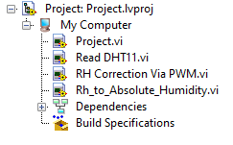
VI Breakdown
Main VI
Sub-VIs
Notes:
Here is a breakdown of the virtual instruments in the project. You can see the main project VI and the three sub VIs written.

Slide 6
Sub VIs

Slide 7
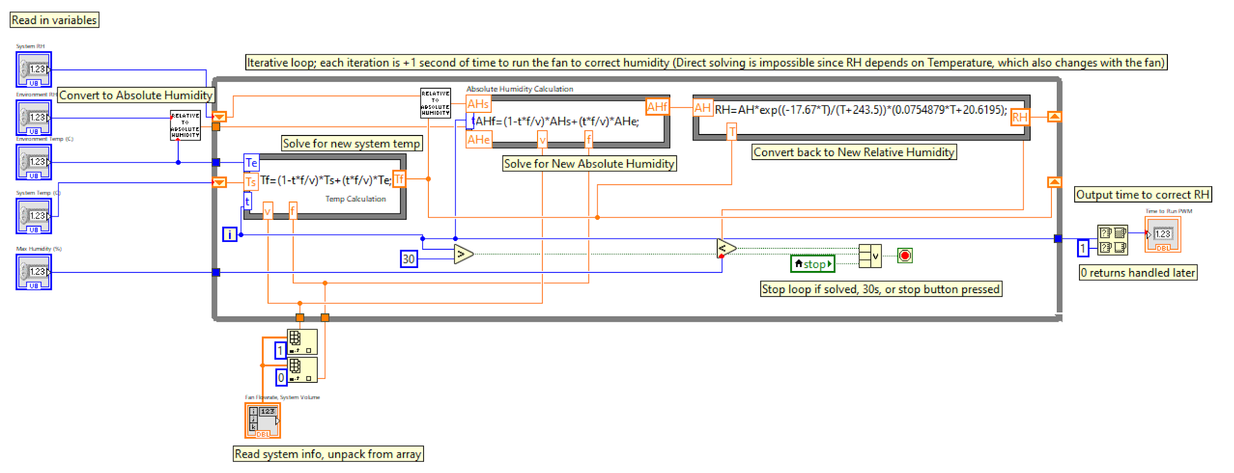
RH Correction Via PWM
Inputs:
System’s and environment’s relative humidity & temp.
Maximum allowed RH
Output:
Number of seconds to run fan
Notes:
This is the Sub VI responsible for modulating the time that the fan is on in order to control temperature and humidity in the chamber. The inputs to this Sub VI are the relative humidity and temperature of both the system and environment as well as the user input maximum allowed RH in the chamber. The VI outputs the number of seconds to run the fan for RH correction.
Since both the RH and temperature change with the fan is run, an iterative solving method was necessary. Each iteration of the solver loop “tests” one additional second of ventilation before outputting the number of seconds required for RH correction.

Slide 8
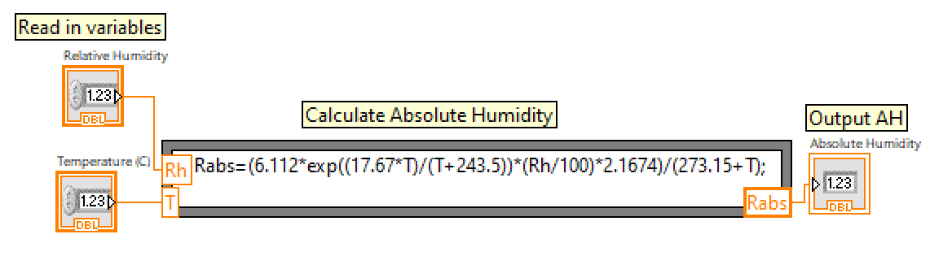
RH to Absolute Humidity
Inputs:
Chamber temperature (C)
Chamber relative humidity (%)
Output:
Absolute humidity
Notes:
Here is the Sub VI that calculates the system’s absolute humidity using inputs of the chamber temperature and relative humidity. This value does not change so it was calculated outside the iterative solver discussed in the last slide.

Slide 9
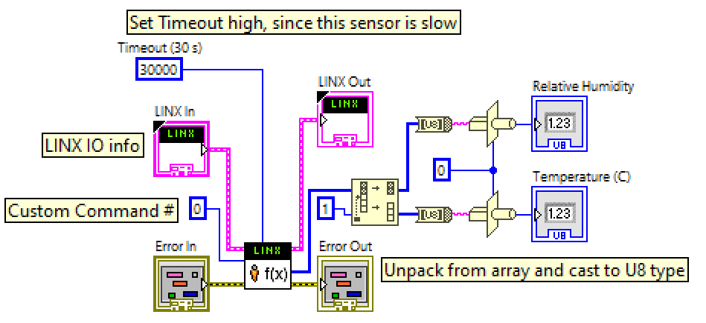
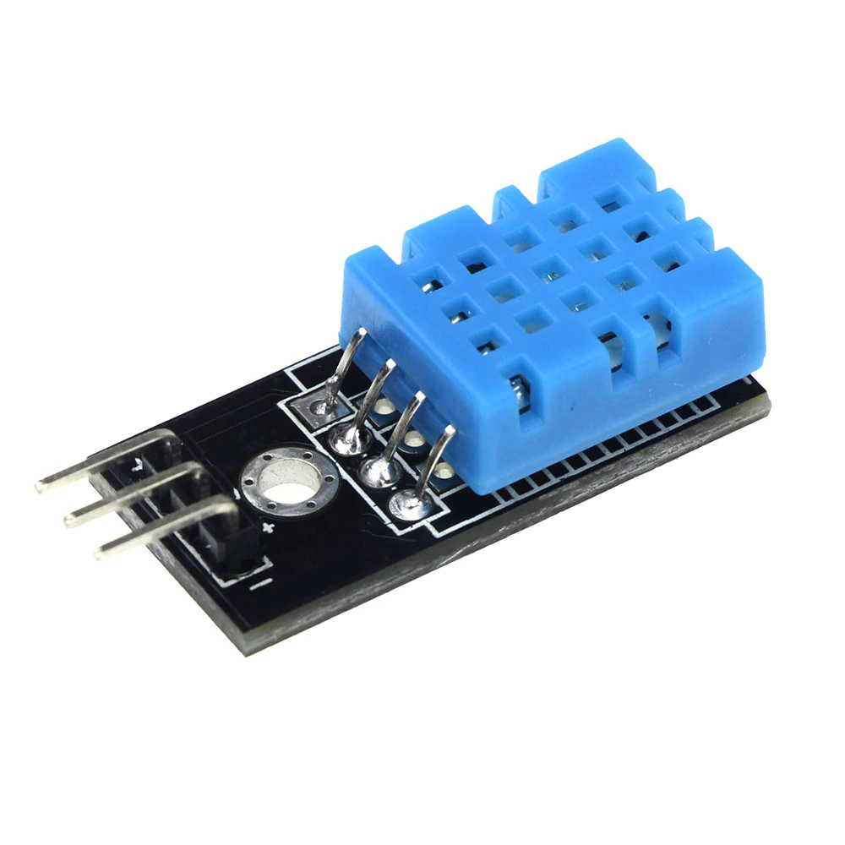
DHT11
Custom LINX Command
DHT11 Hardware
Requires custom firmware on the Arduino
Call a LINX custom command from Labview
Notes:
Here is the Sub VI responsible for utilizing the custom firmware on the Arduino and custom LINX command in LabView to measure temperature and humidity.
The Sub-VI calls LINX Custom Command #0 to run on the Arduino firmware, waiting up to 30 seconds for the command to return an output array. This long delay is to give the Arduino time to finish any pending operations and read the DHT11.
The Arduino recognizes this command number, reads the DHT11 at a fixed port, and returns an array with a reading for both Temperature in Celsius and Relative Humidity.

Slide 10
Main VI Elements

Slide 11
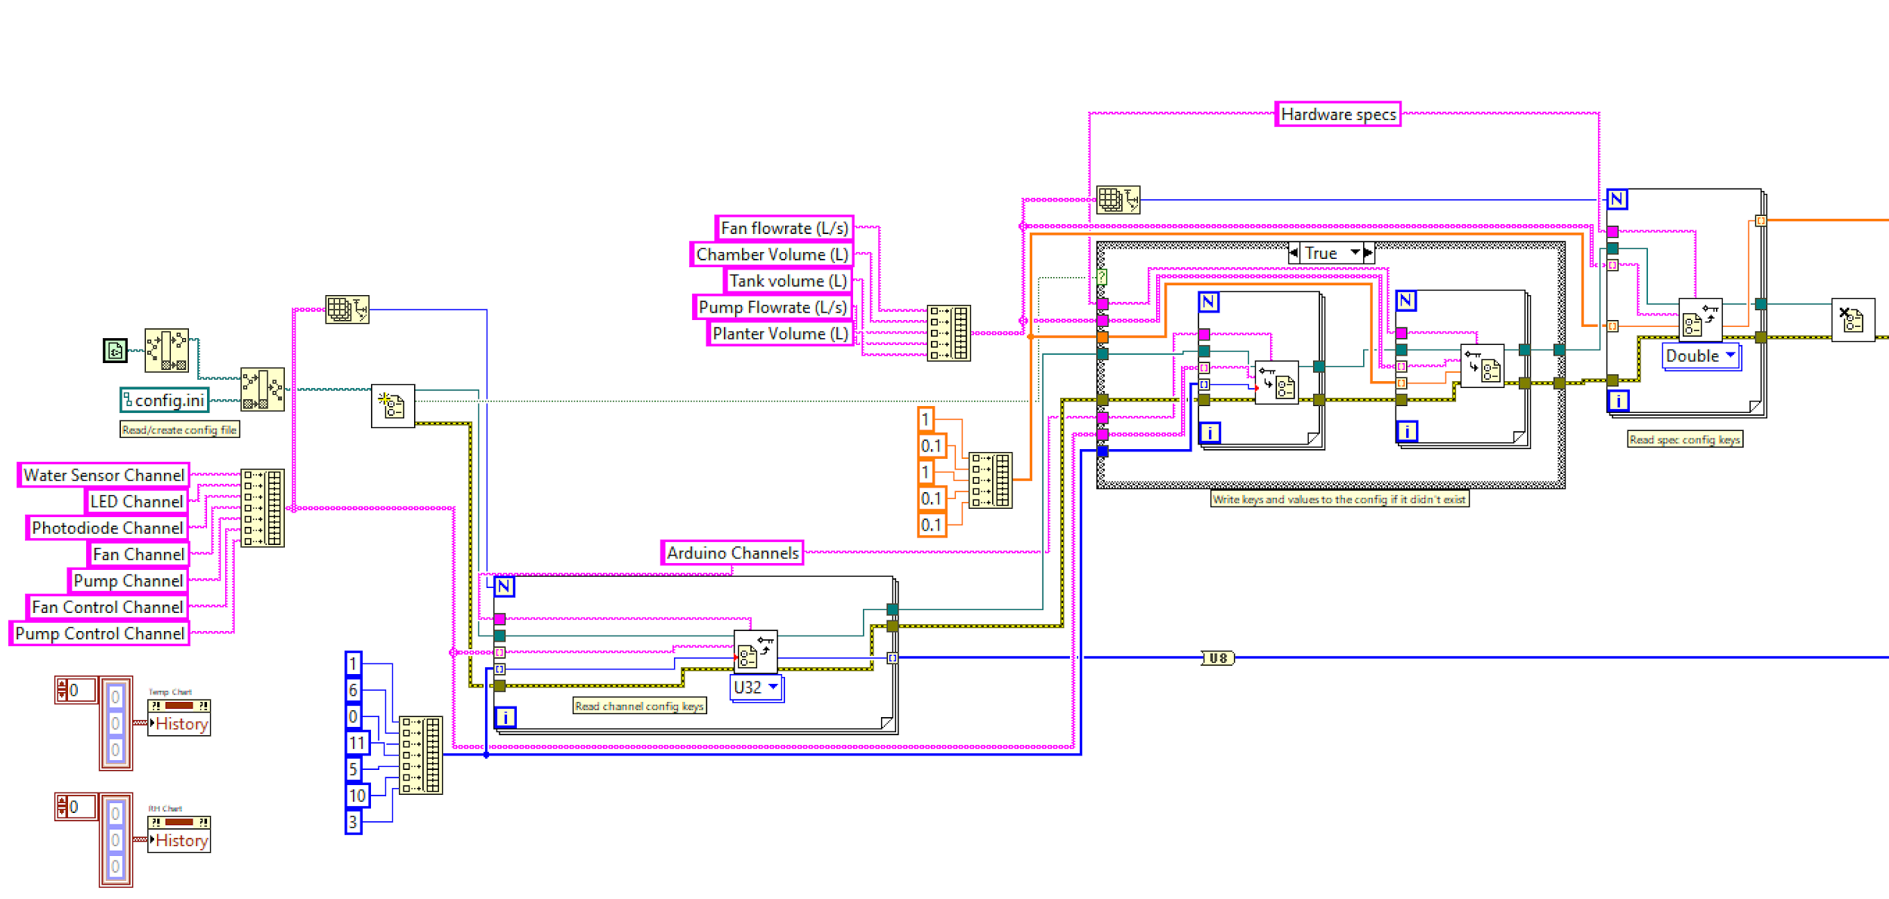
Configuration File Use
Configuration File Reading, Creation, Writing, and Chart Clearing
Notes:
To account for physical differences in hydroponic chambers between users, like chamber size or fan flow rate, the program was written to read in a configuration file of default values.
This section of the code implements configuration file reading, creation, and writing as well as chart clearing.

Slide 12
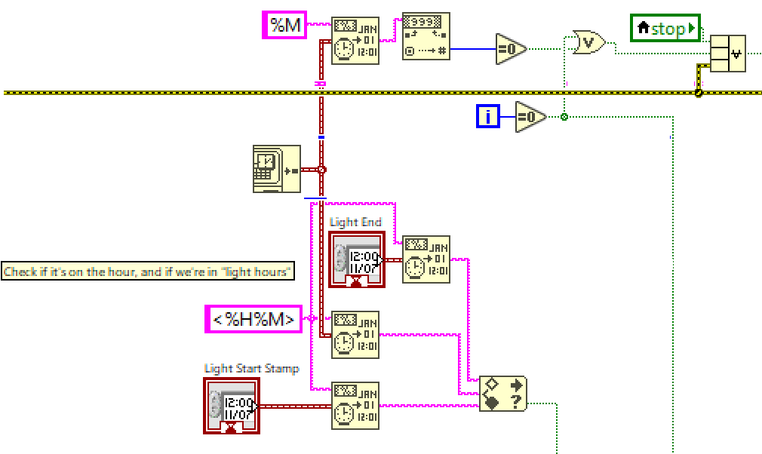
Control of Grow Light
Checking for iteration 0 on the hour and within light hours
Notes:
The main code also implements control of the grow light such that it only turns on when the current time is within predefined light hours and the photodiode reads less than 50% of the allowed maximum.

Slide 13
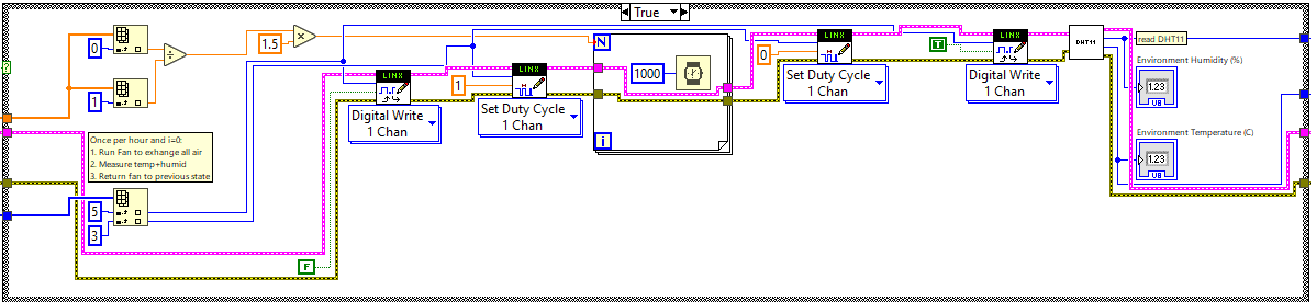
Hourly and Iteration 0 air exchange and DHT11 reading
Notes:
The code also checks to see if the the time is currently on iteration zero or on the start of the hour.
If the logic returned from this check is true, a full air exchange and DHT11 reading is triggered. As a result the motor channel is set to the correct direction and the PWM duty cycle to 100%.

Slide 14
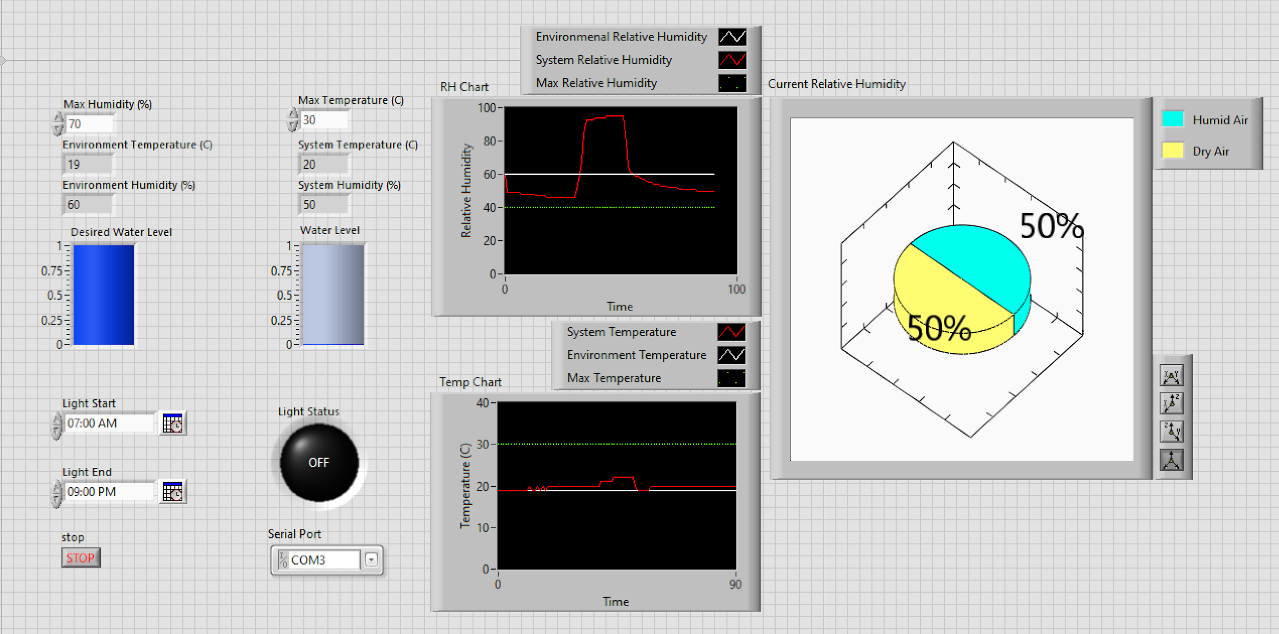
Results: User Interface
Notes:
Here is the user interface. The middle top chart shows a relative humidity spike and correction via ventilation.
On the left side, the user supplies inputs for the desired Maximum Relative Humidity, Max Temperature, Desired Water Level, Light Start/Light End time, and the COM port the Arduino is available on.
Shown to the right are outputs of the system. These include strip charts of Environment, System, and Maximum Temperature and Relative Humidity. Also shown is a visualization of the current Relative Humidity.

Slide 15
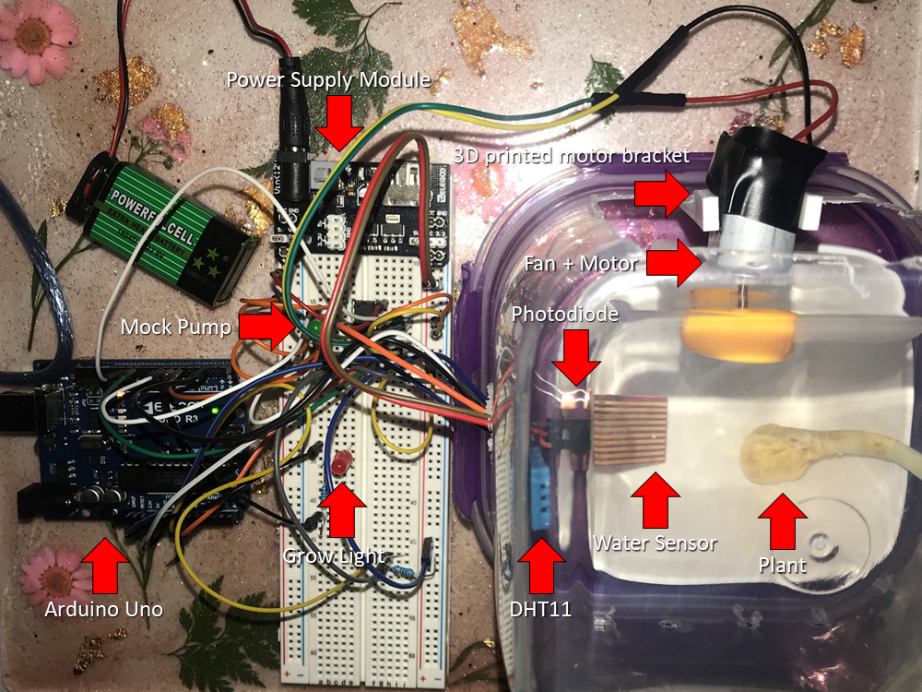
Results: Final system
Notes:
Here is the physical prototype of our final system. On the far right you can see the grow chamber containing the plant, a sprouted garlic clove. The container also holds the water level sensor and temperature and humidity sensor. At the top right is the fan and DC motor held by the custom 3D printed bracket.

Slide 16
Testing Results
Limitations:
Lacking water
Proximity to window
Grow light and indicator worked as designed
DHT11 sensor worked… but fan function was not ideal
Notes:
Overall our test was limited by lacking water in the system (because we didn’t have the water pump ) and also limited by the inability to move a computer near a window for long periods of time to connect to the arduino.
The grow light and indicator worked as designed. When the system was turned on in a dimly lit room during light hours of the system, the grow light and its indicator on the user interface turned on. A flashlight shown on the photodiode turned off the grow light after several seconds.
To test the temperature and humidity corrections, hot, humid air was introduced into the growth chamber until the DHT11 readings triggered the fan to run. The system corrected more slowly than expected which was likely due to moisture condensing on interior surfaces of the chamber and lower than expected fan rate.

Slide 17
Future work
Use a relay and line-level voltage to control a real Grow Light (400 W+)
Add a relay, power supply, water pump, and external water reservoir
Use a better Fan (3D printed replacement possible)
Calibrate photodiode based on light exposure from actual sunlight
Add pH, Total Dissolved Solids (TDS) meters and correction methods
Make code to Arduino-only, or implement remote Labview connection
Permanently wire and enclose the system
Notes:
So, there are lots of things we can improve in the future. Like adding the power supply that can power elements like a real Grow Light and water pump. external water reservoir could be implemented.
There could also be improvements to current elements like using a more effective fan and calibrating the photodiode based on exposure from actual sunlight.
Finally, the code could be translated to Arduino-only or controlled by a remote LabView connection such that the system could be permanently wired and enclosed and run full time.

